Slide 1

Python Level 2
Lesson 7: Two Problems

Slide 2
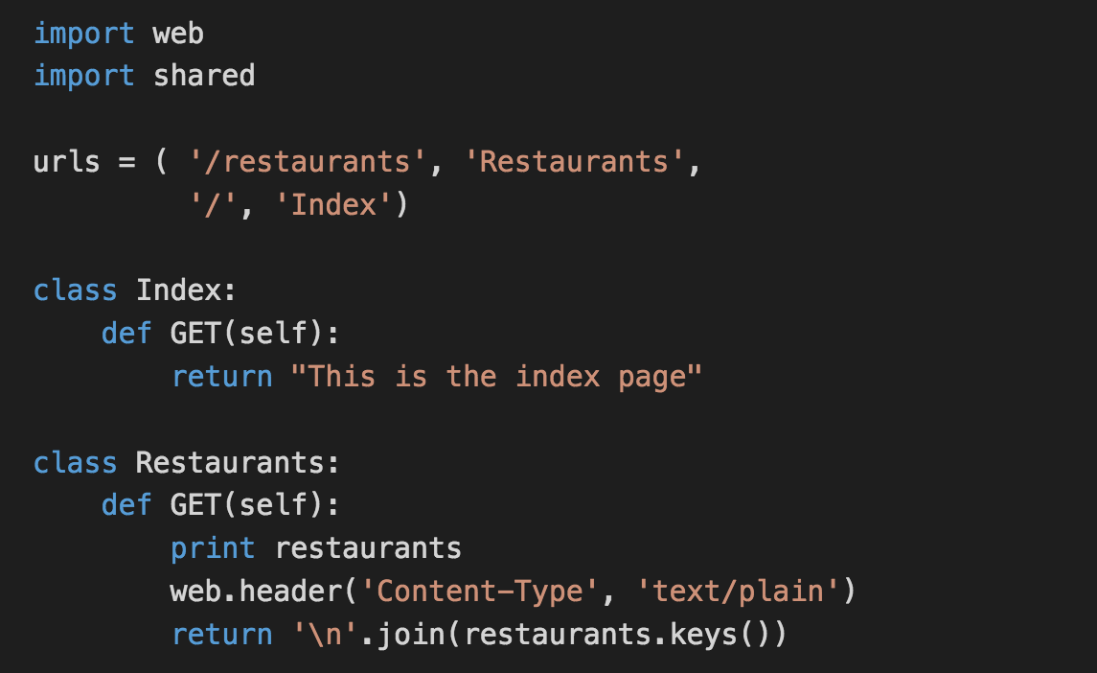

Last time

Slide 3
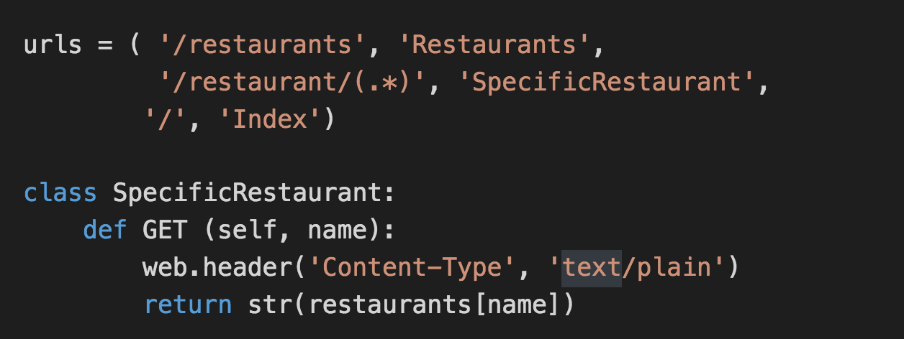
A Specific Restaurant?
Today’s code: http://go/0a13yzbs

Slide 4
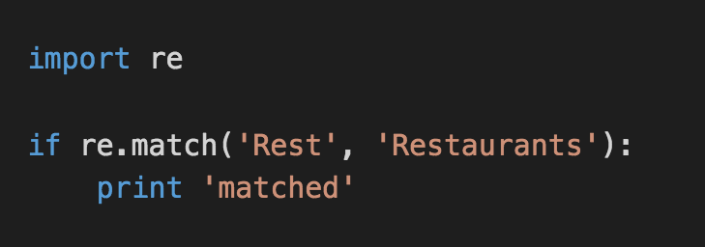
Regular Expressions
A way to match specific parts of a string
Common to almost all modern programming languages

Slide 5
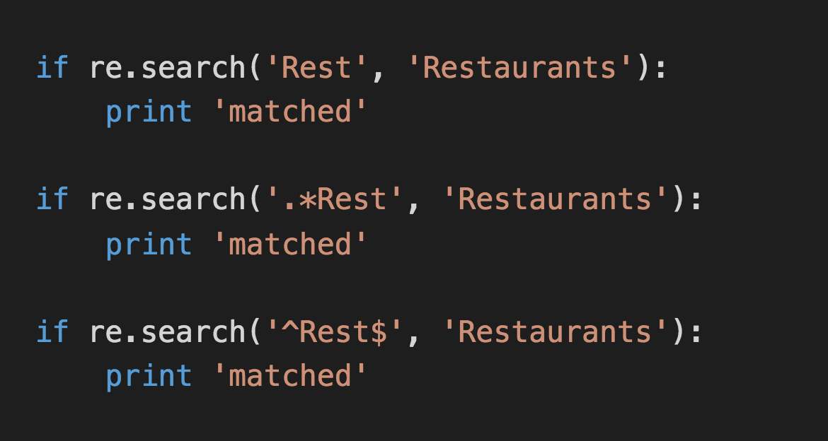
Regular Expressions (continued)

Slide 6
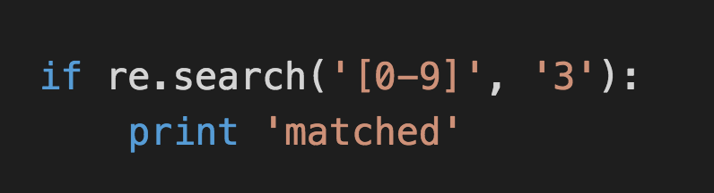
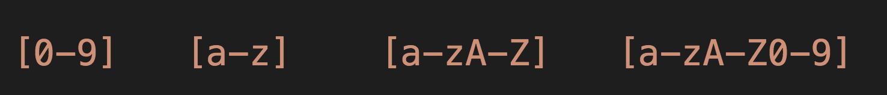
What about numbers?
Square brackets denote a match from a group of characters:

Slide 7
A lesson from history
Some people, when confronted with a problem, think:
“I know, I'll use regular expressions.”
Now they have two problems.
- Jamie Zawinski , 1997
Nightclub proprietor

Slide 8
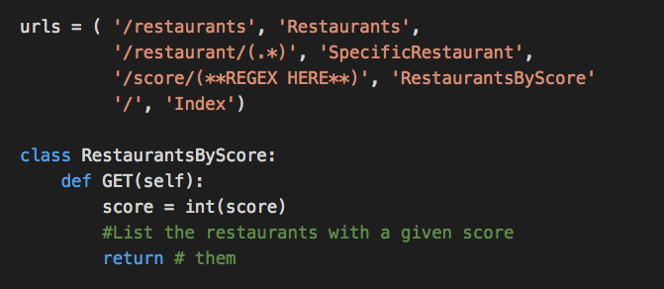
Back to our webserver
Questions? Comments? Come see us in S32, on Monday, 11:00 – 12:00

